Slide 1
Weak-Reality-Two-Stage-Access Bug
Presented by:
Sharbel Dalal
Acquired from the bug project of
310725106
029667722

Slide 2
Background
Two Stage Access Bug
  Accessing same/different table twice
Different Accesses are not synchronized → Erroneous table entries

Slide 3
Story
A programmer implemented an FS
Disk Block Management is done by Allocation Table
The FS is multithreaded → two threads may attempt to access the table simultaneously

Slide 4
Code 1/3
Get Free Block Index – Gets the index of the next free block

Slide 5
synchronized public int getFreeBlockIndex() {
int i;
int count;
int startIndex;
int interval;
int searchDirection;
double randomValue;
int[] primeValues = { 1, 2, 3, 5, 7, 11, 13, 17, 19, 23, 29, 31, 37, 41, 43, 47, 53 };
randomValue = Math.random();
// Choosing randomly start entry for search.
startIndex = (int)Math.floor((vector.length - 1) * randomValue);
// Choosing randomly increment/decrement prime value.
interval = primeValues[(int)Math.floor((primeValues.length - 1) * randomValue)];
// Choosing randomly search direction and starting the search from randomly
// choosen start entry in that direction with the randomly choosen interval.
if (randomValue > 0.5) {
// Searching forward.
for (i = startIndex,count = 0; (count < vector.length) &&
(vector[i] != 'F')
; i = i + interval, i %= vector.length, count++);
} else {
// Searching backward.
for (i = startIndex,count = 0; (count < vector.length) &&
(vector[i] != 'F')
; count++) {
i = i - interval;
if (i < 0) {
i = i + vector.length;
}
}
}
if (count == vector.length) {
return -1; // Indicates "no free block".
}
else {
return i; // Returns the index of the found free block.
}
}

Slide 6
In Short
synchronized public int getFreeBlockIndex() {
  return nextFreeBlock;
  }

Slide 7
Code 2/3
synchronized public void markAsAllocatedBlock(int i) throws Exception {
if (vector[i] != 'A') {
vector[i] = 'A'; // Allocates i-th block.
} else {
throw new Exception("Allocation");
}
}

Slide 8
Code 3/3
synchronized public void markAsFreeBlock(int i) throws Exception {
if (vector[i] != 'F') {
vector[i] = 'F'; // Frees i-th block.
} else {
throw new Exception("Freeing");
}
}

Slide 9
The Buggy Code Lines
1) int k=vector.getFreeBlockIndex();
2)if (k != -1) { vector.markAsAllocatedBlock(k)
}
The buggy scenario could occur if a second thread accesses the table between line 1 and line 2, then it would get the same number of the free block and an error would occur.

Slide 10
Good Example ☺
 |  | … |  | …
1
2
i
n
Thread 1
Thread 2

Slide 11
Buggy Example
 |  | … |  | …
1
2
i
n
Thread 2
Thread 1
Two files writing to the same block

Slide 12
Solution
The programmer needs to make the two operations (read and update) atomic and thus he will solve the bug.
A possible way to solve the bug is to put the two calls in a synchronized block.

Slide 13
RaceFinder Benchmarks
The values on the Y-Axis should be divided by 200 to get the actual percentage.

Slide 14
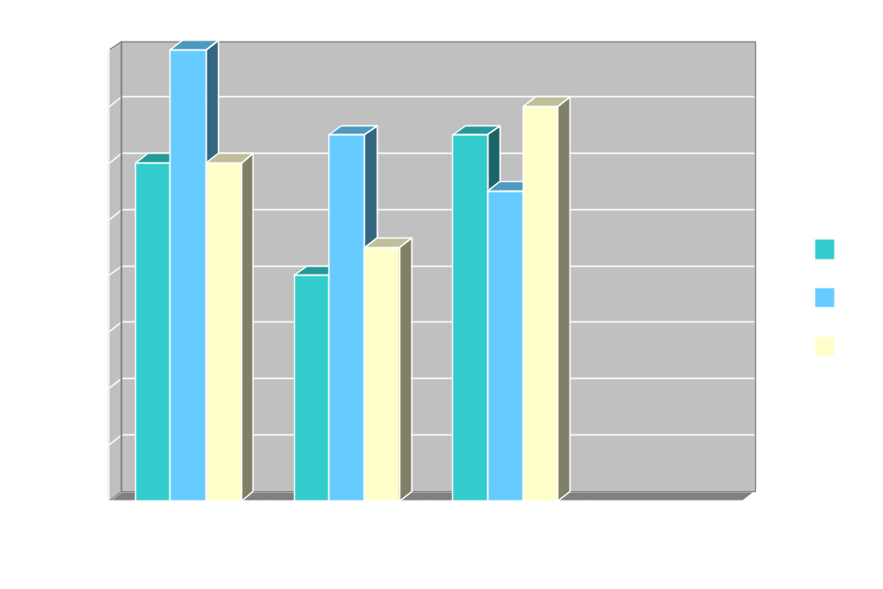
RaceFinder
Little

Slide 15
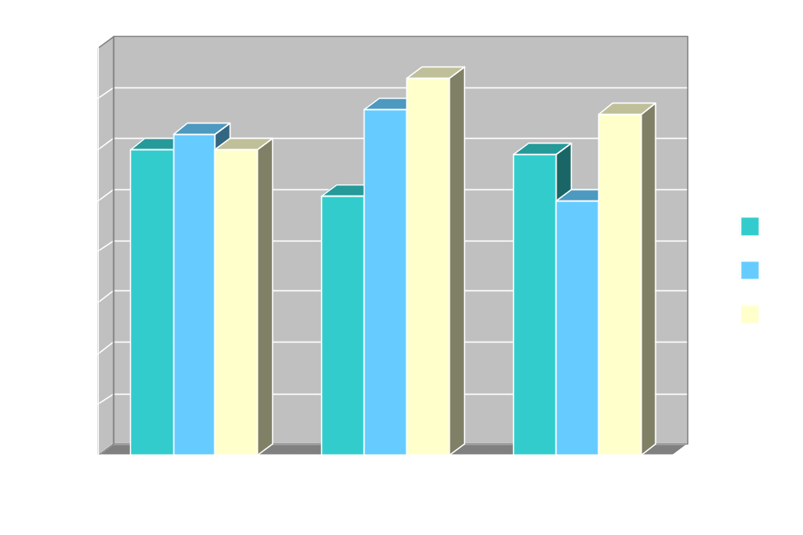
Average

Slide 16
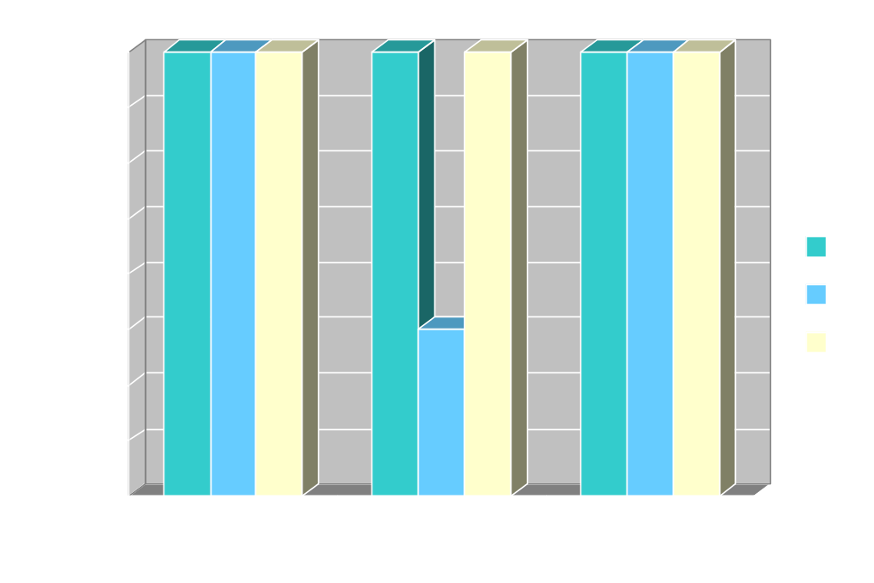
Lot

Slide 17
The End

